Slide 1

Application: MediLink Type: Application Architecture View: Logical View Style: Layered Architecture Pattern
Users
Delivery Channels
Core Business Processes
Data And Integration
Business Layer Implementation
Stores Patient Records
External EHR Data :
Patient Demographs
Doctor Data
Lab results
Imaging Studies
Database
(MySQL or MongoDB)
User Data Record
Backend Services
(Spring Boot and REST API)
Mobile App
Doctor Data Record
Test Reports
Payment Processing Data
Credit & Debit
User Interface
(React, Ionic )
Patient
Authentication Data
Application Hosting Server (AWS)
Browser
Passwords
Deployment Layer
(Github & Jenkin Pipeline)
Integration Logs
Success Logs
Error Logs
Doctors
Payment Records
User Support
(Feedback)
Customer care

Slide 2
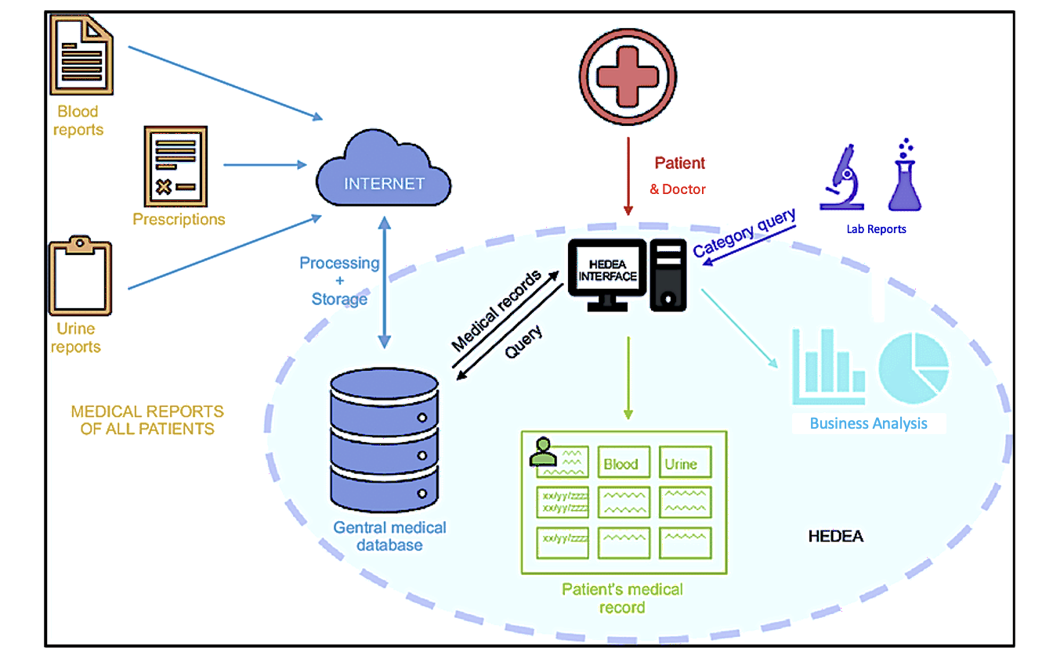
Application: MediLink Type: Application Architecture View: Process View Style: Client-Server Pattern

